Slide 1
2025 MLB Pitch Usage Vs. Success
Luke Schrader
BSAN-360-001
3/20/26
https://github.com/lrs345/BSAN360-Final-Project/tree/main

Slide 2
Data Source
Original Data Sourced from Baseball Savant:
https://baseballsavant.mlb.com/leaderboard/custom?year=2025&type=pitcher&filter=&min=1&selections=p_game%2Cp_formatted_ip%2Cpa%2Cab%2Chit%2Cstrikeout%2Cwalk%2Ck_percent%2Cbb_percent%2Cbatting_avg%2Cslg_percent%2Con_base_percent%2Con_base_plus_slg%2Cp_era%

Slide 3
Description of Original Data
Provides pitcher statistics from 2025 MLB Regular Season
809 Pitchers Included in Data
53 columns of information:
Includes statistics such as Innings Pitched, ERA, Hits Allowed, Average Exit Velocity Allowed, Strikeouts, Walks, etc.
Provides total pitch count for the season, as well as a breakdown of how many of those pitches were fastballs, offspeed pitches, and breaking pitches.

Slide 4
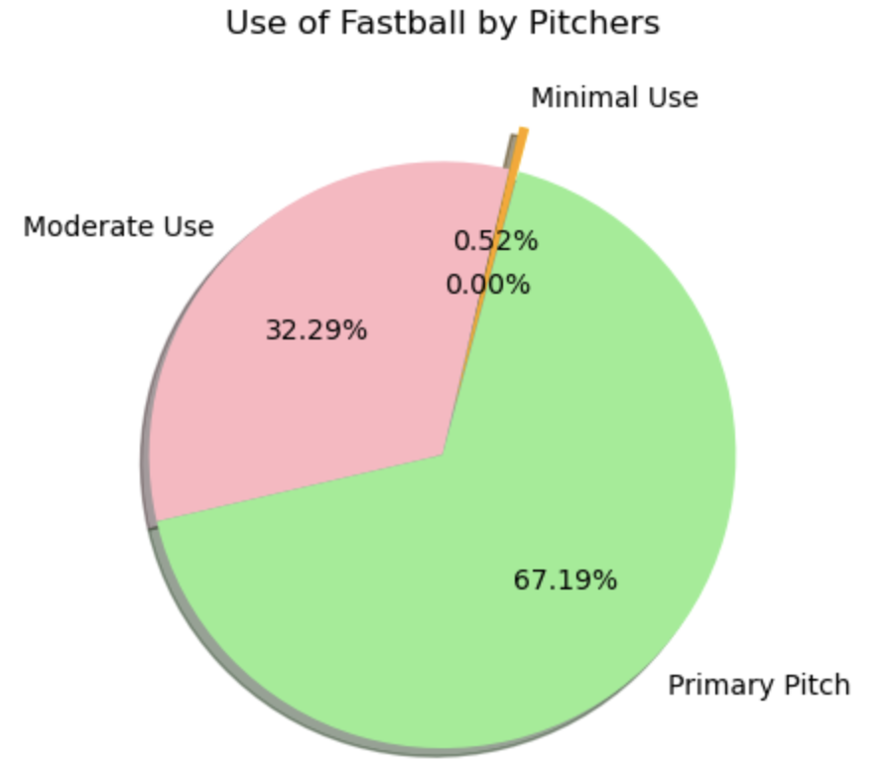
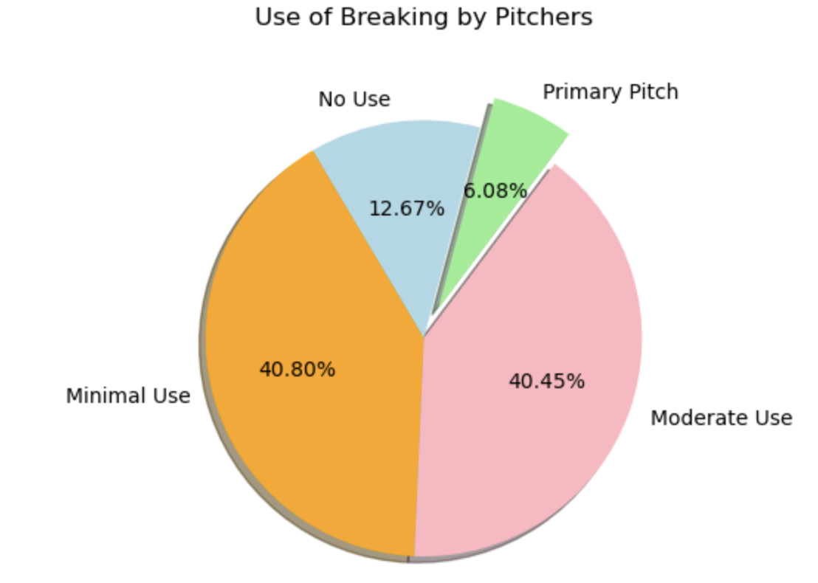
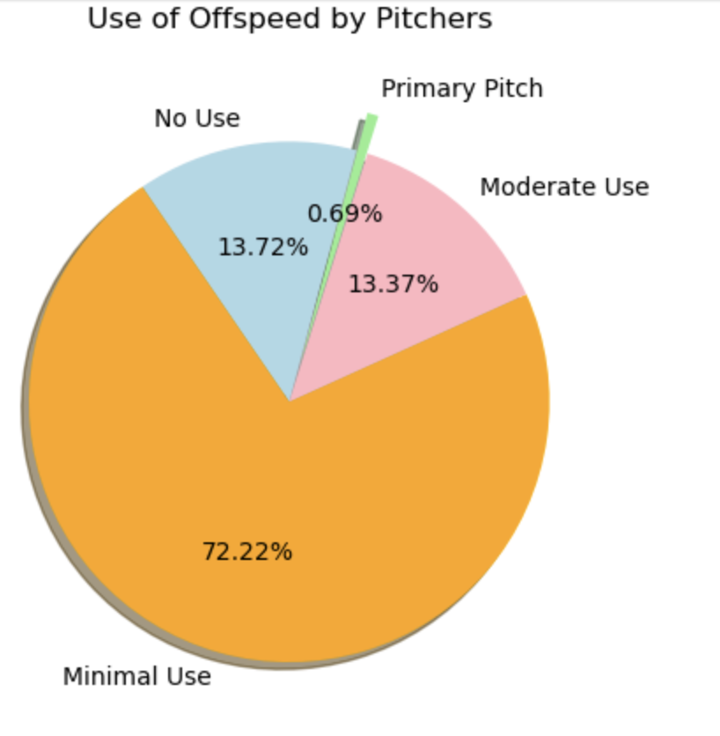
Breakdown of Classifications
Primary Pitch: Pitch used 50% or more of the time
Moderate Use: Pitch used between 25% and 50% of the time
Minimal Use: Pitch used up to 25% of the time
No Use: Pitch is not used by pitcher

Slide 5
Research Questions
Research Question #1: How did pitch mixes affect pitcher success on average in 2025?
Research Question #2: Which pitch mixes create the highest strikeout and walk outputs?
Research Question #3: How much of an effect do strikeouts and walks have on a pitcher’s overall success?

Slide 6
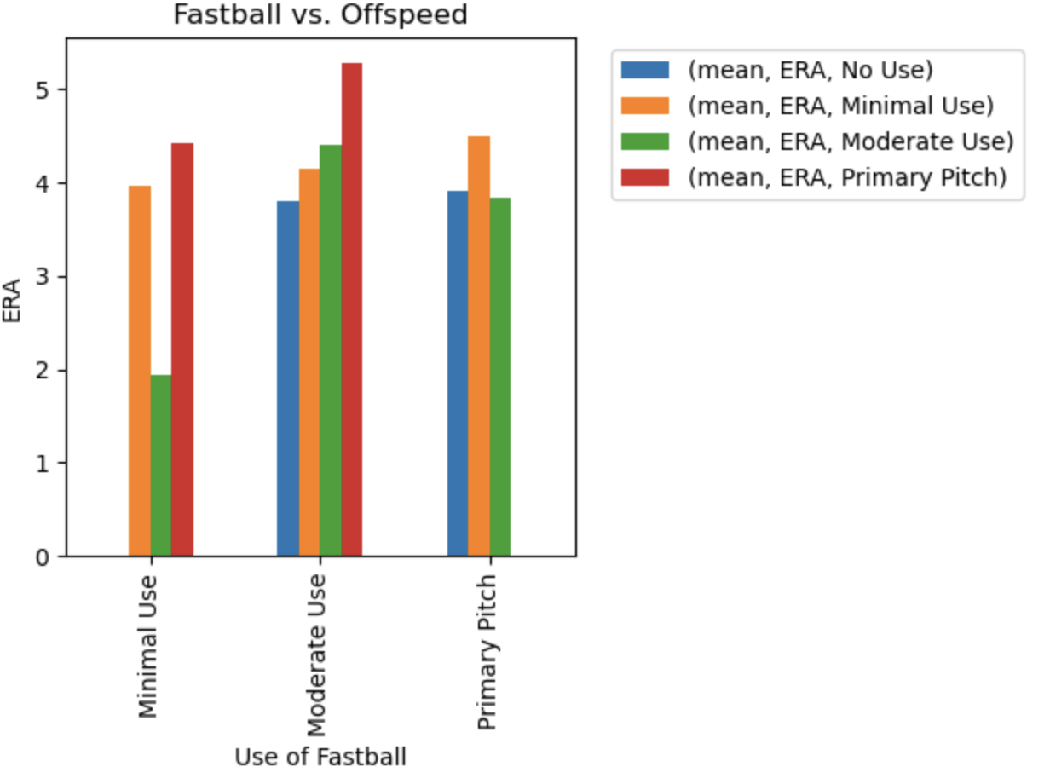
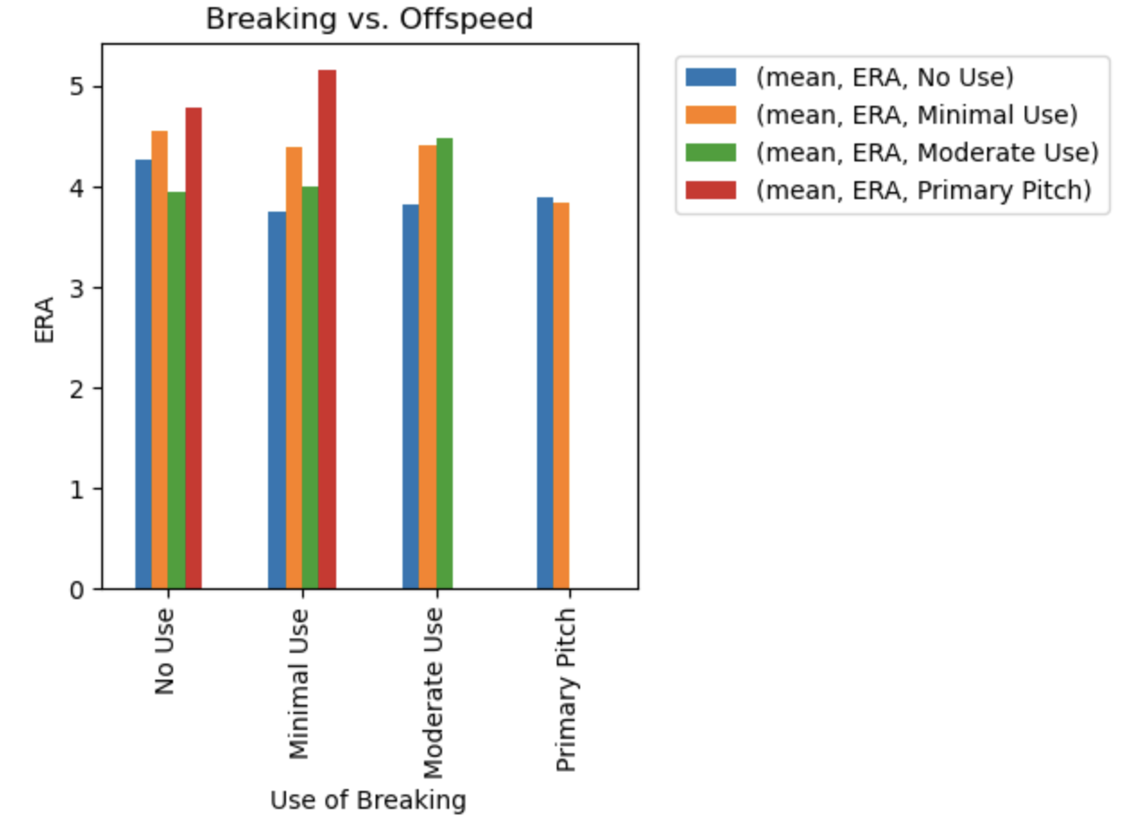
Research Question #1: Pitch Mix Vs. Success
Mean ERA
Fastball | Breaking Pitches | Offspeed Pitches
Primary Pitch | Primary Pitch | Primary Pitch
4.34 | 3.86 | 5.07
Initial Testing of Mean ERAs with primary pitches and ERAs among two pitch combinations show that more use of offspeed (red and green bars) may be associated with higher ERAs

Slide 7

Research Question #1: Pitch Mix Vs. Success
Mean ERA by Use of Offspeed
Primary Pitch | Moderate Use | Minimal Use | No Use
5.07 | 4.10 | 4.39 | 3.89
Grouping by offspeed pitch usage, I ran ANOVA to see if the difference between the ERAs was statistically significant
A p-value of 0.039 signals that there is statistical significance to this. The average pitcher who uses offspeed pitches more often will tend to see higher ERAs.
There was not statistically significant differences between other pitch mix groups

Slide 8
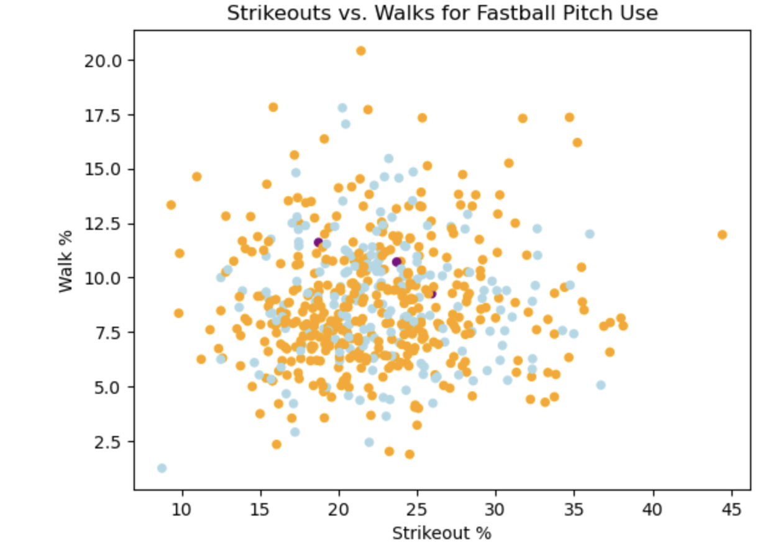
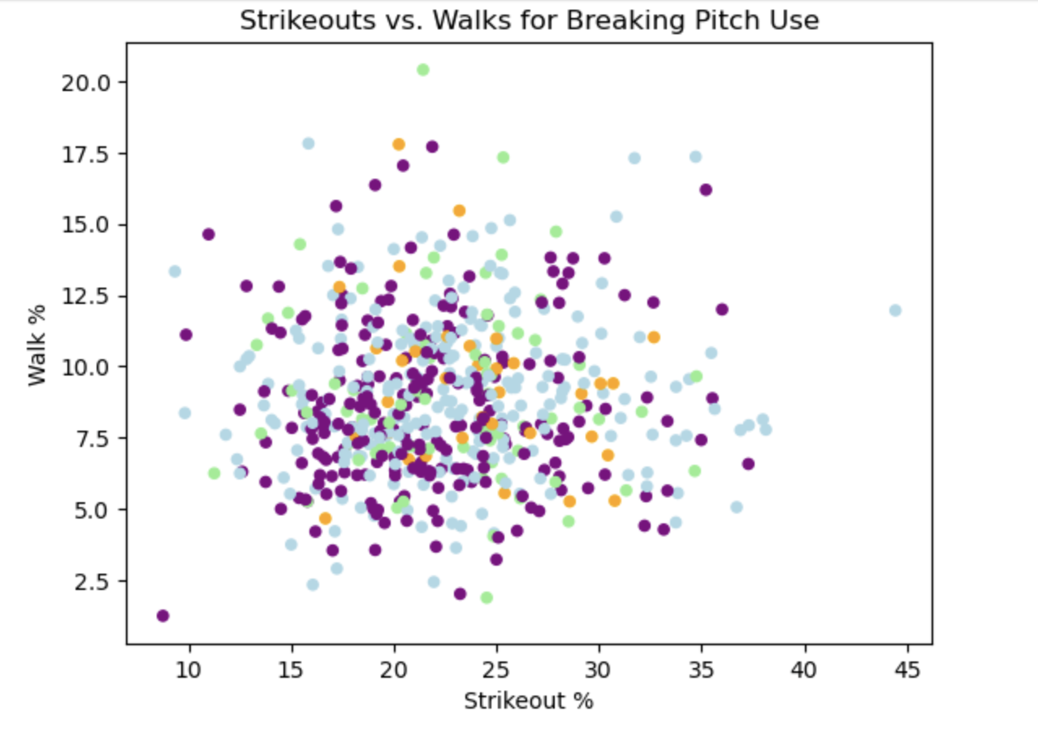
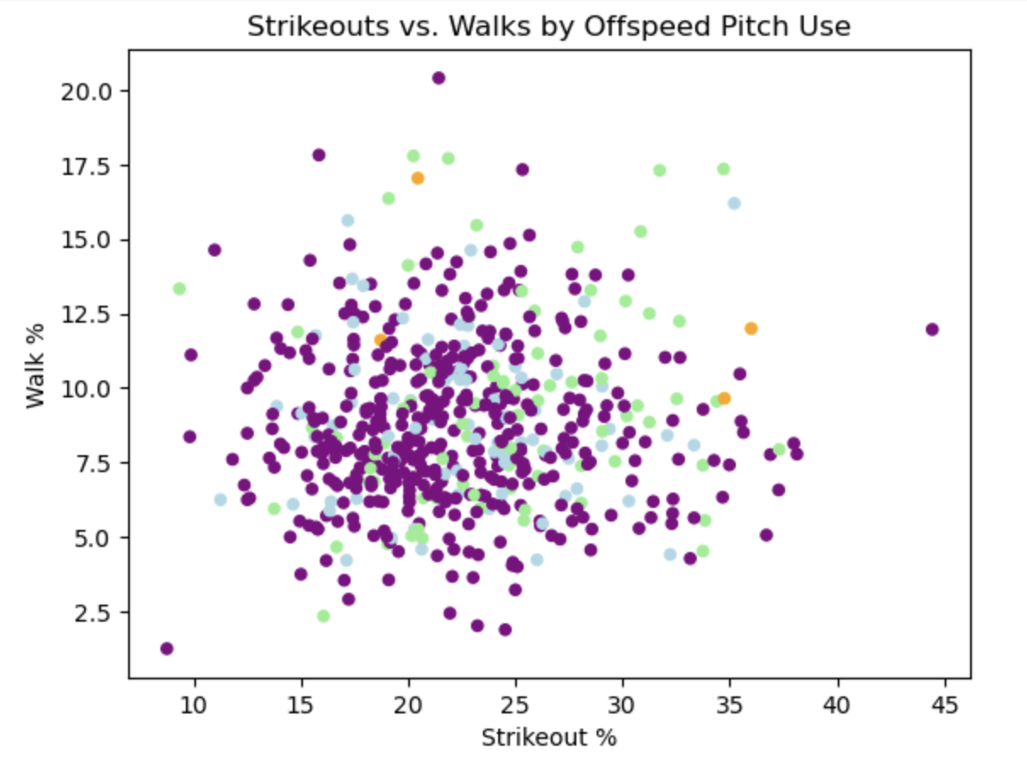
Research Question #2: Pitch Types Relationship with Ks and BBs
No Use: Green
Minimal Use Purple
Moderate Use: Light Blue
Primary Pitch: Orange
Those who are not using offspeed tend to be striking out and walking batters more.
There are more outliers in both strikeouts and walks for primary fastball pitchers.
Minimal breaking pitch use seems to strikeout players a bit less on average but are also walking batters a bit less than the other groups.

Slide 9
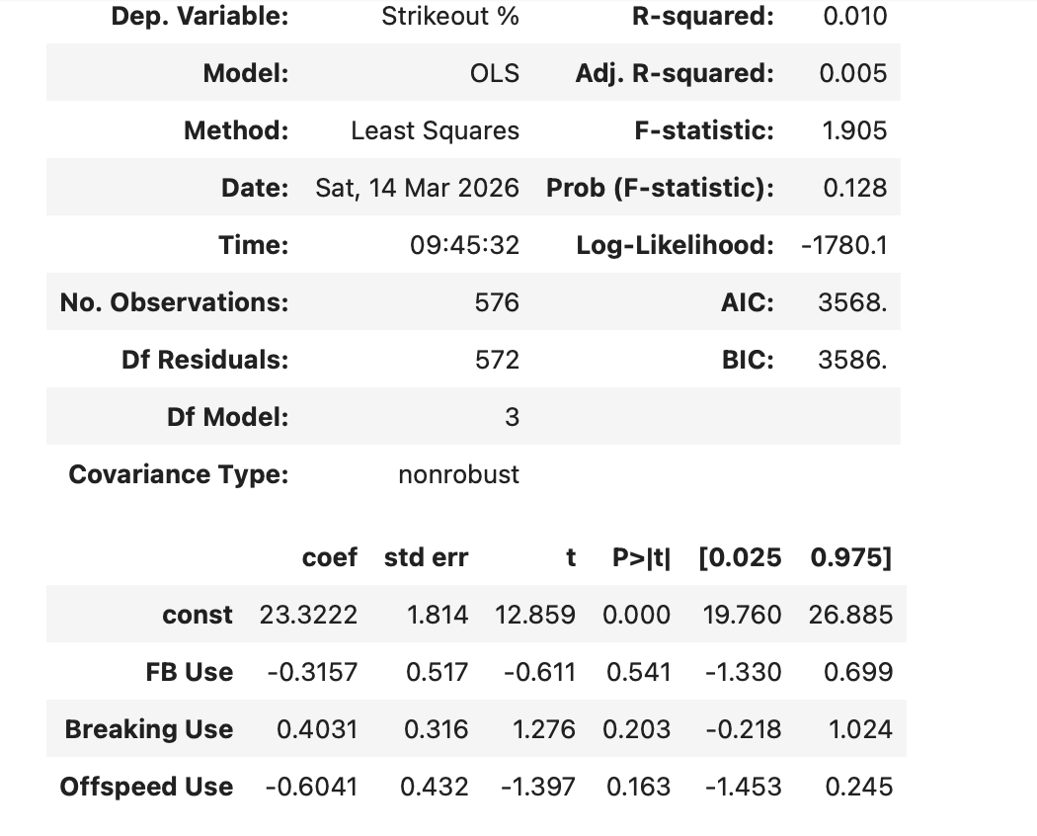
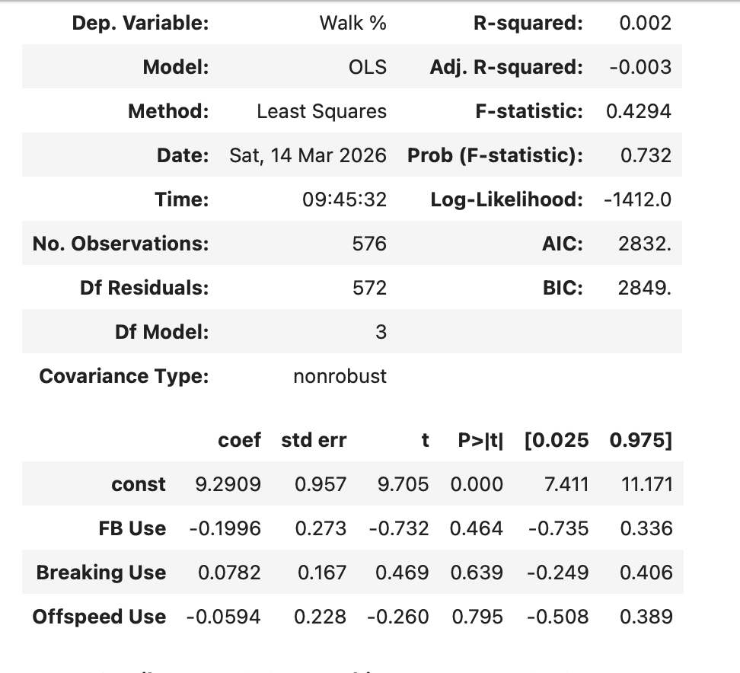
Research Question #2: Pitch Types Relationship with Ks and BBs
Regression on K% using Pitch Types
Regression on BB% using Pitch Types
All p-values are above 0.05, signaling there is no relationship between pitch usage and Strikeout rates
In addition, pitch usage only accounts for 1% of variation in Strikeout rate
All p-values are above 0.05, signaling there is no relationship between pitch usage and Walk rates
In addition, pitch usage accounts for less than 1% of variation in Walk rate

Slide 10
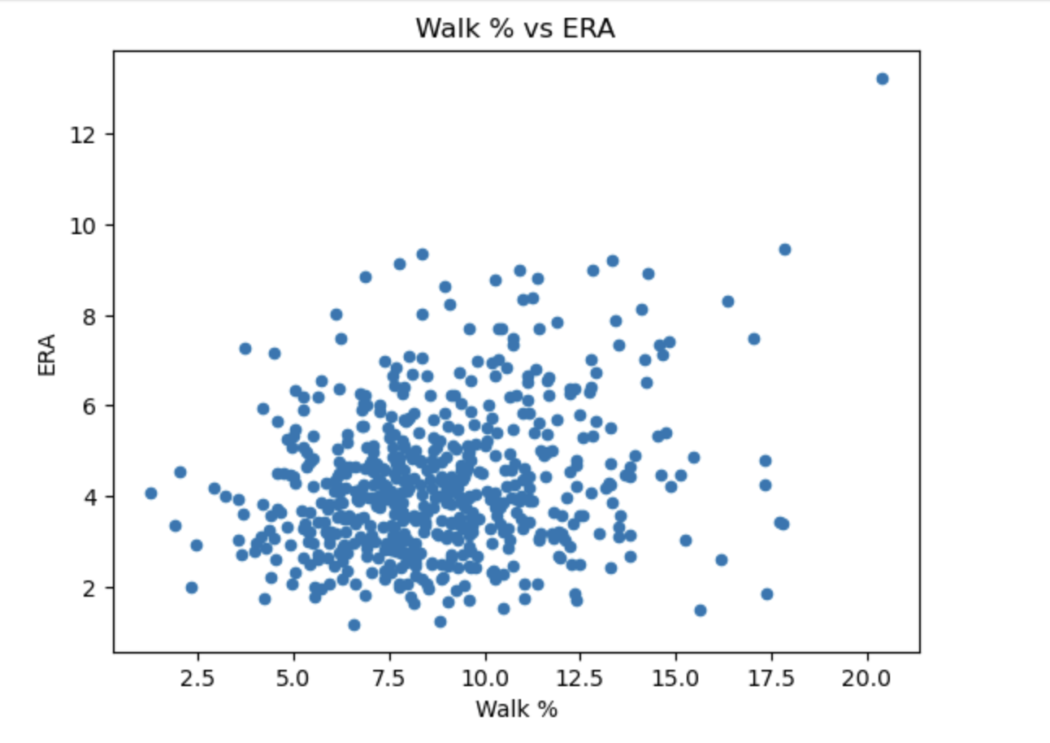
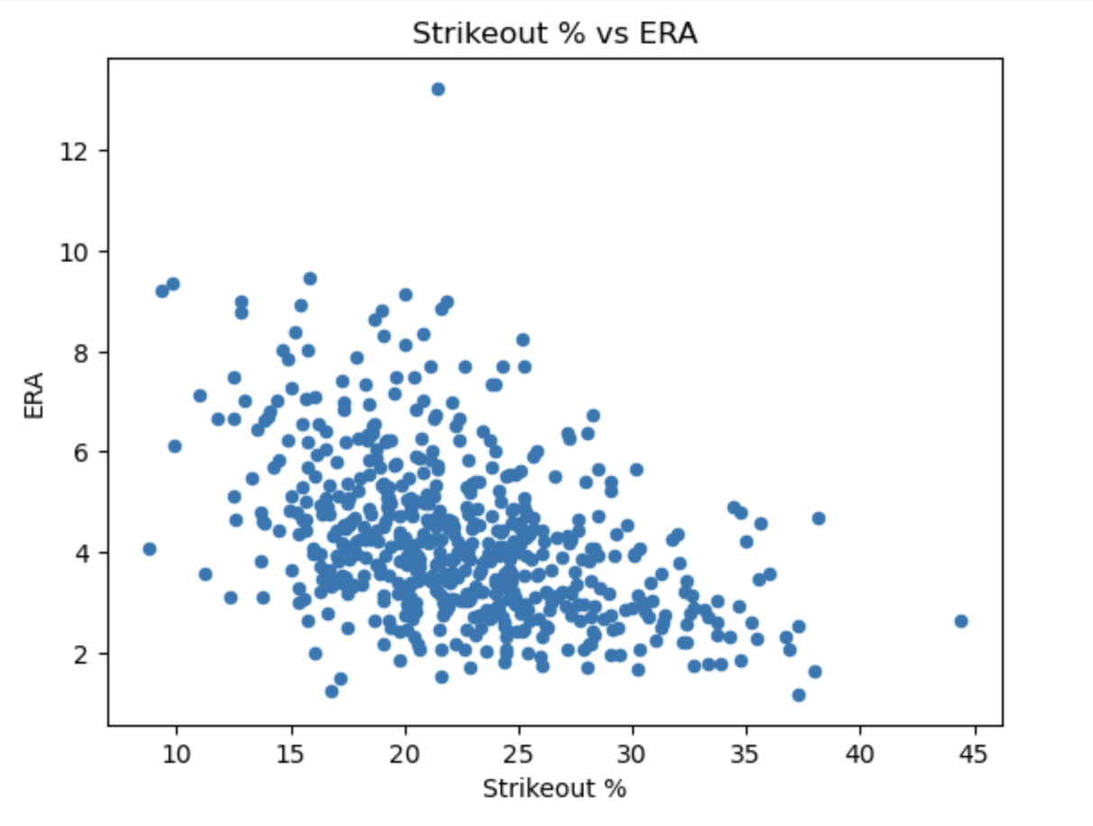
Research Question #3: Ks and BBs Affect on Success
Higher BB percentages seemed to lead to higher ERAs
Higher K percentages seemed to lead to lower ERAs

Slide 11
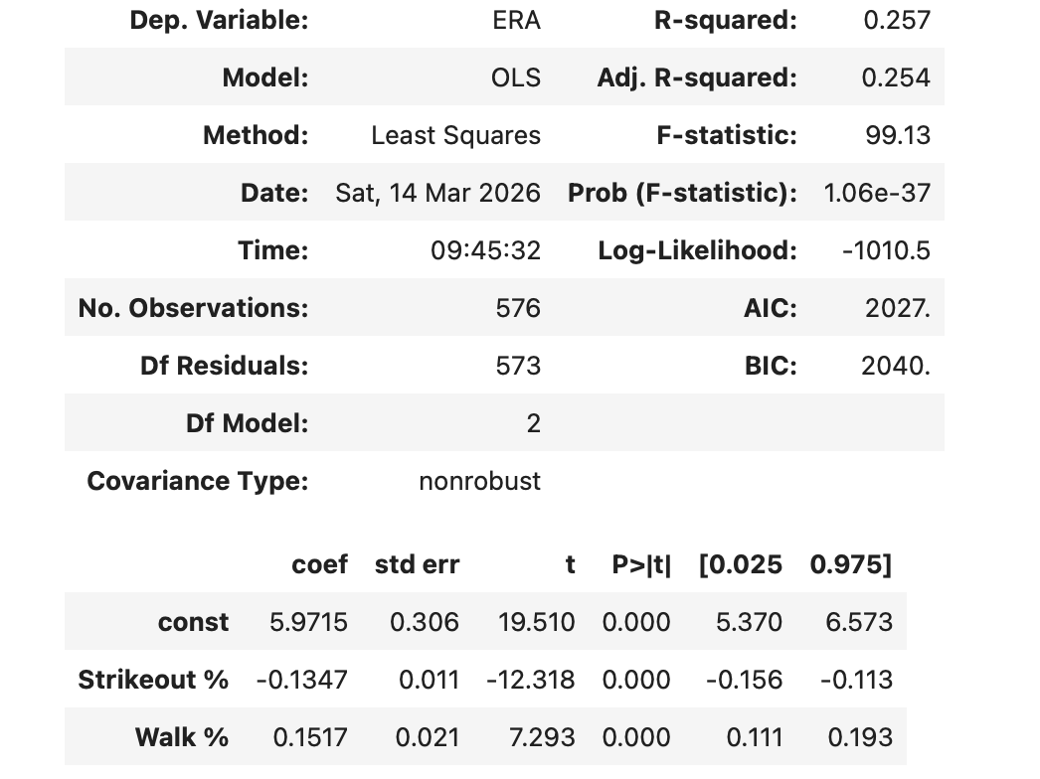
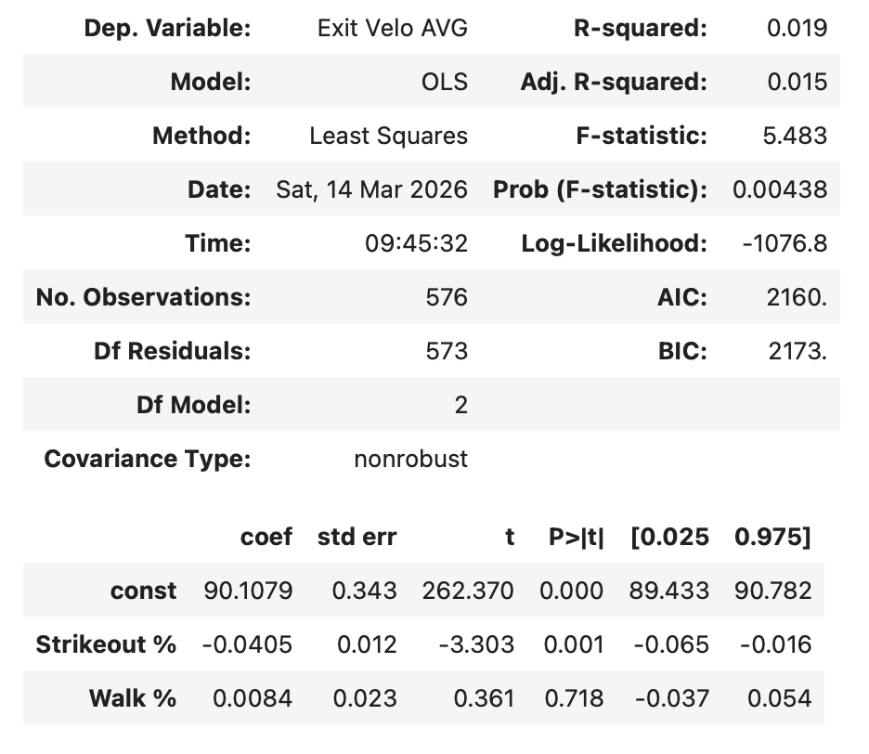
Research Question #3: Ks and BBs Affect on Success
Regression on ERA using K% and BB%
Regression on Exit Velocity Allowed using K% and BB%
K% has a significant inverse correlation to ERA (p-value rounded to 0)
BB% does not have a correlation with Exit Velocity Allowed (p-value rounded to 0.72)
K% and BB% explain only about 2% of variation in Average Exit Velocity Allowed
K% has a significant inverse correlation to ERA (p-value rounded to 0)
BB% has a significant positive correlation to ERA (p-value rounded to 0)
K% and BB% explain about 25.7% of variance in ERAs

Slide 12
Conclusion
Research Question #1: How did pitch mixes affect pitcher success on average in 2025?
Less use of offspeed pitches resulted in lower pitcher ERAs. This may be due to more dominant fastballs or offspeed pitches, which move more and have been described by hitters as harder to hit when quality.
Research Question #2: Which pitch mixes create the highest strikeout and walk outputs?
Although there are some outliers, there is not a statistically significant difference in the usage of different pitch types and the corresponding strikeout and walk rates
Research Question #3: How much of an effect do strikeouts and walks have on a pitcher’s overall success?
Both high strikeout rates and lower walk rates work lead to lower ERAs, making up about 25% of the variation in ERAs among pitchers
Higher Strikeout Rates lead to lower batter exit velocities. If it is harder to make contact, it should be harder for a batter to make hard contact.
Walk rates do not have a statistically significant effect on batter exit velocities. Wild pitchers are not necessarily harder to make harder contact off of when they do throw strikes

